Slide 1

CS4225/CS5425 Big Data Systems for Data Science
NoSQL and Basics of Distributed Databases
Bryan Hooi
School of Computing
National University of Singapore
bhooi@comp.nus.edu.sg

Slide 2
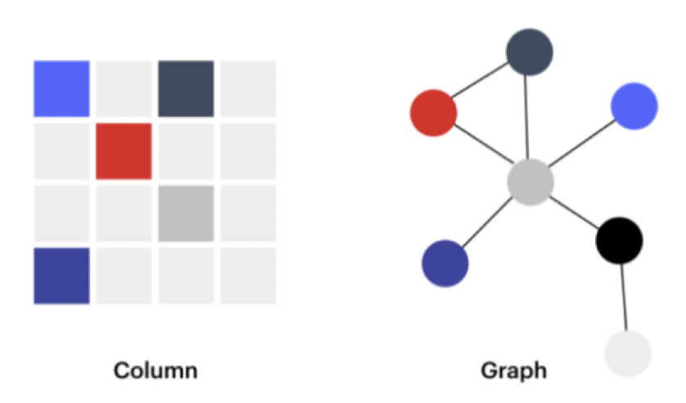
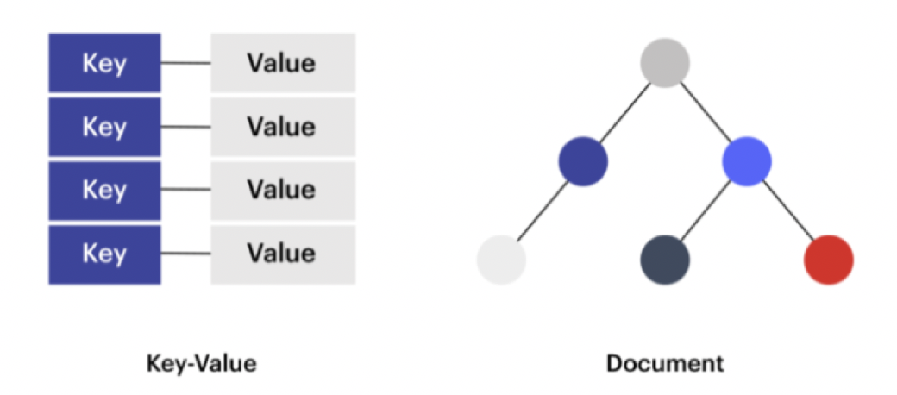
Recap: NoSQL
NoSQL refers to non-relational databases
NoSQL has come to stand for “Not Only SQL”, i.e. using relational and non-relational databases alongside one another

Slide 3

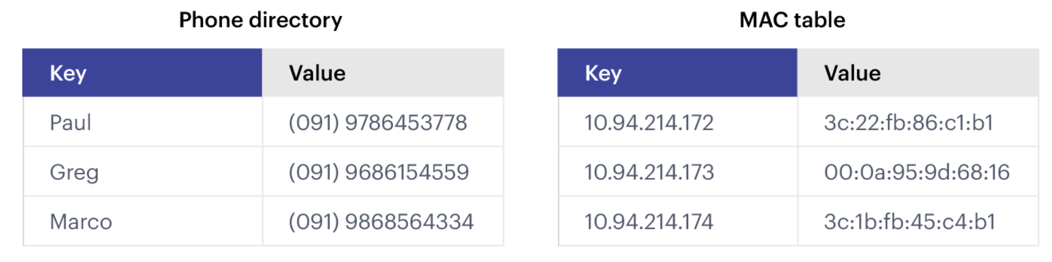
Recap: Key-Value Stores
Operations: get, put, multi-get, multi-put, range queries
Types: persistent, non-persistent (in-memory)
Very fast reads and writes – suitable for cases like caches / user profile info, where we usually need to read / write all the data from an object at a time
Notes:
It supports very simple but flexible data models.

Slide 4


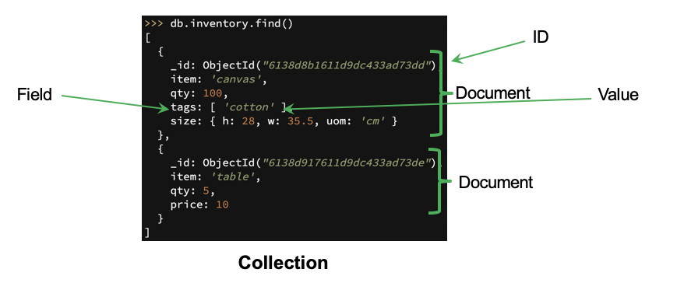
Recap: Document Stores
Collections have multiple documents (i.e. JSON object)
Operations: CRUD (create, update, read, destroy) – similar to SQL queries, but without fixed schema
Suitable for queries involving the content of each document
Notes:
It supports very simple but flexible data models.

Slide 5
Recap: Strong vs Eventual Consistency
Weight=60kg
Weight=60kg
Weight=60kg
Weight=60kg
Weight=60kg
Weight=60kg
60kg
60kg
60kg
50kg
Strong consistency: any reads immediately after an update must give the same result on all observers
Eventual consistency: if the system is functioning and we wait long enough, eventually all reads will return the last written value

Slide 6
Clarification: Strong Consistency vs ACID
If you’ve taken a database class, you may recall that the C in ACID stands for “Consistency”
This is almost completely unrelated with “Strong Consistency”!
“Consistency” in ACID: means the database must always obey certain predefined constraints (e.g. inventory counts cannot be negative)
Strong Consistency (in distributed systems): any reads immediately after an update give the same result on all observers
The names came from different communities (ACID from the database community; Strong Consistency from distributed systems)
Note: since we didn’t discuss ACID much in this class, we consider it as not required knowledge for exam purposes

Slide 7
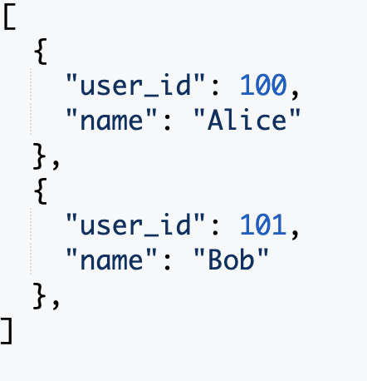
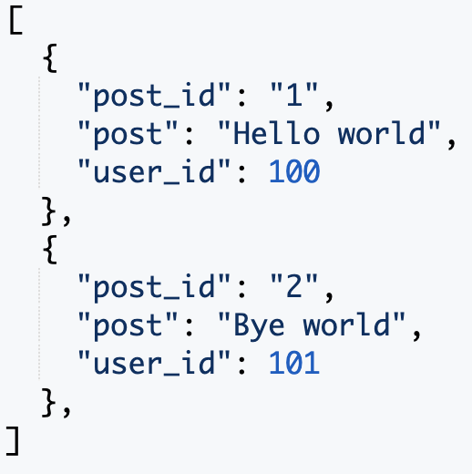
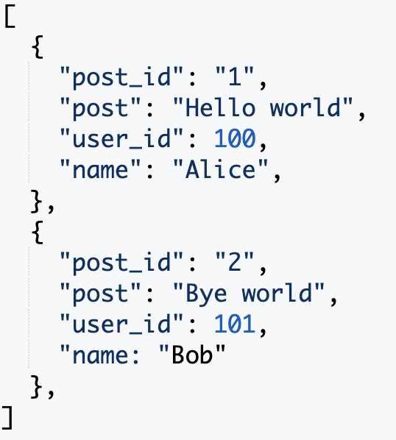
Recap: Duplication
Users
Posts
Posts ( + username)
‘Storage is cheap: why not just duplicate data to improve efficiency?’
Tables are designed around the queries we expect to receive
Leads to a new problem: what if user changes their name? (this needs to be propagated to multiple tables)
Notes:
Duplication means that when updating the table, there is additional costs involved in keeping the tables in sync. So this is a tradeoff between fast reads and writes but additional update costs in NoSQL. In some cases updates may be rare, or even can be ignored, i.e. we allow the tables to go out of sync, which may be fine for some applications (e.g. it may be fine to display a post with the user name “at time of posting”). So in the end it is a tradeoff that has to be carefully made based on profiling, application / business needs etc.

Slide 8


Recap: Pros & Cons of NoSQL Systems
Pros
Cons
+ Flexible / dynamic schema: suitable for less well-structured data
+ Horizontal scalability: we will discuss this more next week
+ High performance and availability: due to their relaxed consistency model and fast reads / writes
- No declarative query language: query logic (e.g. joins) may have to be handled on the application side, which can add additional programming
- Weaker consistency guarantees: application may receive stale data that may need to be handled on the application side
Conclusion: no one size fits all. Depends on needs of application: whether denormalization is suitable; complexity of queries (joins vs simple read/writes); importance of consistency (e.g. financial transactions vs tweets); data volume / need for availability.
Source: Cattell (2010). Scalable SQL and NoSQL Data Stores. SIGMOD Record.

Slide 9
Today’s Plan
Basic Concepts of Distributed Databases
Data Partitioning
Query Processing in NoSQL
Source: Cattell (2010). Scalable SQL and NoSQL Data Stores. SIGMOD Record.

Slide 10
Introduction and Motivation
In today’s lecture, we focus on how NoSQL systems are implemented as distributed databases.
Many of today’s concepts will be relevant to distributed databases more generally, including both NoSQL, as well as relational databases.
Why distributed databases?
Scalability: allow database sizes to scale simply by adding more nodes
Availability / Fault Tolerance: if one node fails, others can still server requests
Latency: generally, each request is served by the closest replica, reducing latency, particularly when the database is distributed over a wide geographical area (e.g., globally)

Slide 11
Data Transparency
Users should not be required to know how the data is physically distributed, partitioned, or replicated.
A query that works on a single node database should still work on a distributed database.

Slide 12

Assumption of Distributed Databases
All nodes in a distributed database are well-behaved (i.e. they follow the protocol we designed for them; not ‘adversarial’ or trying to corrupt the database)
Out of syllabus: If we cannot trust the other nodes, we need a ‘Byzantine Fault Tolerant’ protocol, which allows the system to function correctly even when some of its nodes behave arbitrarily (including maliciously). Blockchains achieve this goal (using a decentralized ledger, and various consensus mechanisms)

Slide 13
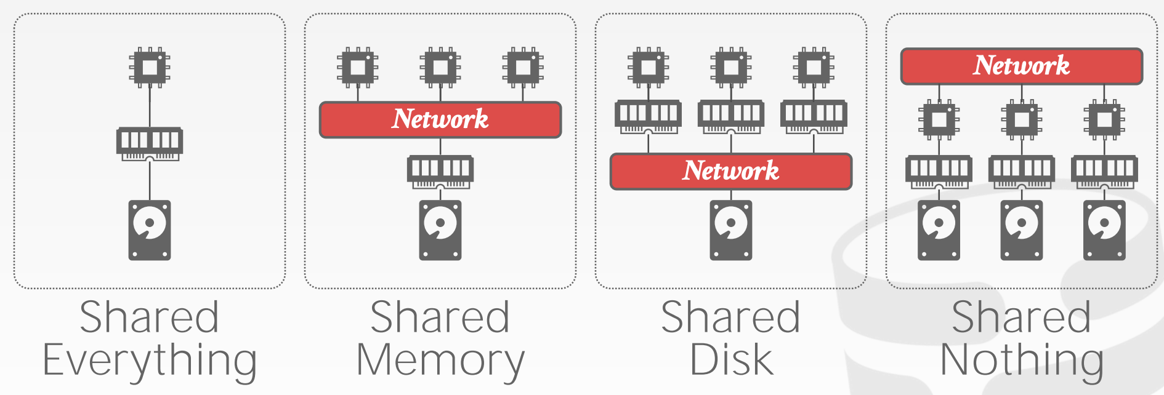






Distributed Database Architectures
Examples:
Single node DBMS
Supercomputers
Cloud databases
NoSQL (mostly)
Credit: Andy Pavlo (CMU CS15-446)

Slide 14
Today’s Plan
Basic Concepts of Distributed Databases
Data Partitioning
Query Processing in NoSQL
Source: Cattell (2010). Scalable SQL and NoSQL Data Stores. SIGMOD Record.

Slide 15
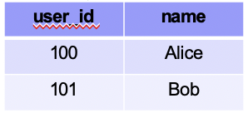
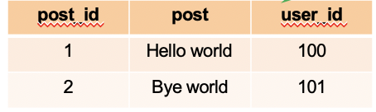
Table Partitioning
Put different tables (or collections) on different machines
Partition 1
Partition 2
Problem: scalability – each table cannot be split across multiple machines

Slide 16
Horizontal Partitioning
Different tuples are stored in different nodes
Partition Key
Partition 1
Partition 2
user_id | name
100 | Alice
101 | Bob
user_id | name
100 | Alice
user_id | name
101 | Bob
Also called “sharding”
Partition Key (or “shard key”) is the variable used to decide which node each tuple will be stored on: tuples with the same shard key will be on the same node
How to choose partition key? If we often need to filter tuples based on a column, or “group by” a column, then that column is a suitable partition key
Example: if we filter tuples by user_id=100, and user_id is the partition key, then all the user_id=100 data will be on the same partition. Data from other partitions can be ignored (called ‘partition pruning’), which saves time as we don’t have to scan these tuples.
Notes:
Recall in mapreduce where the key is used to decide which reducer each reducer handles each tuple; this is similar

Slide 17

Horizontal Partitioning
Different tuples are stored in different nodes
Partition Key
Partition 1
Partition 2
user_id | name
100 | Alice
101 | Bob
user_id | name
100 | Alice
user_id | name
101 | Bob
Q: imagine you have an e-commerce company, which stores a document database containing customer information. You use each user’s city, city_id as a partition key; when is this good / bad?

Slide 18
Horizontal Partitioning
Different tuples are stored in different nodes
Partition Key
Partition 1
Partition 2
user_id | name
100 | Alice
101 | Bob
user_id | name
100 | Alice
user_id | name
101 | Bob
Q: imagine you have an e-commerce company, which stores a document database containing customer information. You use each user’s city, city_id as a partition key; when is this good / bad?
A: Good if we mostly query data only by cities, or read/write data for individual cities, allowing partition pruning. Bad if there are too few cities (called low cardinality), and this causes a lack of scalability. A similar problem occurs if some cities have too high frequency (e.g. most users are from Singapore). Sometimes, these can be mitigated using composite keys (a combination of multiple keys)

Slide 19
Horizontal Partitioning – Range Partition
Different tuples are stored in different nodes
Partition Key
Partition 1
Partition 2
user_id | name
100 | Alice
101 | Bob
1 ≤ user_id ≤ 100
101 ≤ user_id < 200
user_id | name
100 | Alice
user_id | name
101 | Bob
Range Partition: split partition key based on range of values
Beneficial if we need range-based queries. In the above example, if the user queries for user_id < 50, all the data in partition 2 can be ignored (‘partition pruning’); this saves a lot of work
But: range partitioning can lead to imbalanced shards, e.g. if many rows have user_id = 0
Splitting the range is automatically handled by a balancer (it tries to keep the shards balanced)

Slide 20
Horizontal Partitioning – Hash Partition
Different tuples are stored in different nodes
Partition Key
Partition 1
Partition 2
user_id | name
100 | Alice
101 | Bob
1 ≤ hash(100) ≤ 16
17 ≤ hash(101) < 32
user_id | name
100 | Alice
user_id | name
101 | Bob
Hash Partition: hash partition key, then divide that into partitions based on ranges
Hash function automatically spreads out partition key values roughly evenly
Question: in previous approaches, how to add / remove a node? If we completely redo the partition, a lot of data may have to be moved around, which is inefficient.
Answer: consistent hashing

Slide 21
Consistent Hashing
Think of the output of the hash function as lying on a circle:
31
0
1
Partition Key
…
10
user_id | name
100 | Alice
101 | Bob
hash(100)=10
hash(101)=25
25

Slide 22
Consistent Hashing
Think of the output of the hash function as lying on a circle:
31
0
1
Partition Key
…
Node 2
10
user_id | name
100 | Alice
101 | Bob
hash(100)=10
hash(101)=25
25
Node 3
Node 1
How to partition: each node has a ‘marker’ (rectangles)

Slide 23
Consistent Hashing
Think of the output of the hash function as lying on a circle:
31
0
1
Partition Key
…
Node 2
10
user_id | name
100 | Alice
101 | Bob
hash(100)=10
hash(101)=25
25
Node 3
Node 1
How to partition: each node has a ‘marker’ (rectangles)
Each tuple is placed on the circle, and assigned to the node that comes clockwise-after it

Slide 24
Consistent Hashing
Think of the output of the hash function as lying on a circle:
31
0
1
Partition Key
…
Node 2
10
user_id | name
100 | Alice
101 | Bob
hash(100)=10
hash(101)=25
25
Node 3
Node 1
To delete a node, we simply re-assign all its tuples to the node clock-wise after this one

Slide 25
Consistent Hashing
Think of the output of the hash function as lying on a circle:
31
0
1
Partition Key
…
Node 2
10
user_id | name
100 | Alice
101 | Bob
hash(100)=10
hash(101)=25
25
Node 3
Node 1
Similarly, to add a node, we add a new marker, and re-assigning all tuples which now belong to the new node

Slide 26
Consistent Hashing
Think of the output of the hash function as lying on a circle:
31
0
1
Partition Key
…
Node 2
10
user_id | name
100 | Alice
101 | Bob
hash(100)=10
hash(101)=25
25
Node 3
Node 1
Simple replication strategy: replicate a tuple in the next few (e.g. 2) additional nodes clockwise after the primary node used to store it

Slide 27
Consistent Hashing
31
0
1
Partition Key
…
Node 1
user_id | name
100 | Alice
101 | Bob
Node 2
10
hash(100)=10
hash(101)=25
25
Node 3
Node 3
Node 2
Node 1
Multiple markers: we can also have multiple markers per node. For each tuple, we still assign it to the marker nearest to it in the clockwise direction.
Benefit: when we remove a node (e.g. node 1), its tuples will not all be reassigned to the same node. So, this can balance load better.

Slide 28
Today’s Plan
Basic Concepts of Distributed Databases
Data Partitioning
Query Processing in NoSQL

Slide 29
Architecture of MongoDB
Routers (mongos): handle requests from application and route the queries to correct shards

Slide 30
Architecture of MongoDB
Routers (mongos): handle requests from application and route the queries to correct shards
Config Server: stores metadata (e.g., which data is on which shard)

Slide 31
Architecture of MongoDB
Routers (mongos): handle requests from application and route the queries to correct shards
Config Server: stores metadata (e.g., which data is on which shard)
Replica sets: multiple processes which maintain the same data, for redundancy
Each replica set is responsible for a subset of the database, known as a shard (this is a horizontal partitioning scheme)

Slide 32
Example of Read or Write Query
find({‘class’:’cs4225’})
find({‘class’:’cs4225’})
Query is issued to a router (mongos) instance

Slide 33
Example of Read or Write Query
find({‘class’:’cs4225’})
find({‘class’:’cs4225’})
Query is issued to a router (mongos) instance
With help of config server, mongos determines which shards to query

Slide 34
Example of Read or Write Query
find({‘class’:’cs4225’})
find({‘class’:’cs4225’})
find({‘class’:’cs4225’})
find({‘class’:’cs4225’})
Query is issued to a router (mongos) instance
With help of config server, mongos determines which shards to query
Query is sent to relevant shards (partition pruning)
Example: when reading a specific value of the shard key, the config server can determine that the query only needs to go to one shard (the one that contains that value of the shard key); writes are similar
But if the query is based on a key other than the shard key, it is relevant to all shards, and thus will go to all shards

Slide 35
Example of Read or Write Query
find({‘class’:’cs4225’})
find({‘class’:’cs4225’})
find({‘class’:’cs4225’})
find({‘class’:’cs4225’})
{‘name’:’alice’,’class’:’cs4225’}
{‘name’:’bob’,’class’:’cs4225’}
Query is issued to a router (mongos) instance
With help of config server, mongos determines which shards to query
Query is sent to relevant shards (partition pruning)
Shards run query on their data, and send results back to mongos

Slide 36
Example of Read or Write Query
find({‘class’:’cs4225’})
find({‘class’:’cs4225’})
{‘name’:’alice’,’class’:’cs4225’}
{‘name’:’bob’,’class’:’cs4225’}
find({‘class’:’cs4225’})
find({‘class’:’cs4225’})
{‘name’:’alice’,’class’:’cs4225’}
{‘name’:’bob’,’class’:’cs4225’}
Query is issued to a router (mongos) instance
With help of config server, mongos determines which shards to query
Query is sent to relevant shards (partition pruning)
Shards run query on their data, and send results back to mongos
​​mongos merges the query results and returns the merged results to the application

Slide 37
Example of Read or Write Query
find({‘class’:’cs4225’})
find({‘class’:’cs4225’})
{‘name’:’alice’,’class’:’cs4225’}
{‘name’:’bob’,’class’:’cs4225’}
find({‘class’:’cs4225’})
find({‘class’:’cs4225’})
{‘name’:’alice’,’class’:’cs4225’}
{‘name’:’bob’,’class’:’cs4225’}
Query is issued to a router (mongos) instance
With help of config server, mongos determines which shards to query
Query is sent to relevant shards (partition pruning)
Shards run query on their data, and send results back to mongos
​​mongos merges the query results and returns the merged results to the application

Slide 38
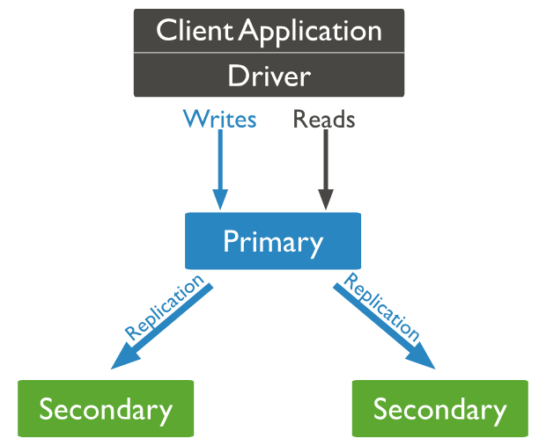
Replication in MongoDB
Common configuration: 1 primary, 2 secondaries
Writes:
The “Primary” receives all write operations
Records writes onto its “operation log”
Secondaries will then replicate this operation log, apply it to their local copies of the data (thus ensuring data is synchronized), then acknowledge the operation
Reads:
The user can configure the “read preference”, which decides whether we can read from secondaries (this is the default), or the primary
Allowing reading from secondaries can decrease latency and distribute load (improving throughput), but allows for reading stale data (it has only “eventual consistency”)
Elections:
If the primary node fails, the nodes “conduct an election”, which is a protocol to choose one of the secondaries to be promoted to primary

Slide 39
Conclusion: Reasons for Scalability & Performance of NoSQL
Horizontal partitioning: as we get more and more data, we can simply partition it into more and more shards (even if individual tables become very large)
Horizontal partitioning improves speed due to parallelization.
Duplication (i.e. denormalization): Unlike relational DBs where queries may require looking up multiple tables (joins), using duplication in NoSQL allows queries to go to only 1 collection.
Relaxed consistency guarantees: prioritize availability over consistency – can return slightly stale data

Slide 40
First Half Wrap-up + Exam Info
Questions generally focus on understanding and application:
Integrative: Require you to combine knowledge from different chapters of the textbook
“Application”: Require you to apply your knowledge of fundamental concepts to reasonably practical scenarios.
“Why not”: Example, Tommy proposed a solution A to solve problem B in the lecture. Tell me what is the problem with solution A and how to overcome this problem
In general: if you have successfully understood the concepts we have discussed in lecture, you should be able to answer the test questions.
General focus is on understanding of concepts / principles and understanding when various algorithms / systems should be used; not on knowing particular details of specific software implementations

Slide 41
Scope of Exam
Scope: content discussed in the lecture which appears in slides
Out of scope:
Content only found in the notes underneath the slides (these can be ignored)
Content only discussed in response to student questions (i.e. beyond the scope of the slides)
Content marked with “Details” or that I mentioned is out of scope
If there are any tasks which ask for code, they will allow pseudocode. As long as your pseudocode is reasonable / understandable by the grader, we will accept it.
Historical details

Slide 42
Tips for Designing MapReduce Programs
In exam, only pseudocode will be required (if you want to write in Python / Java, that is fine too). As long as your pseudocode is “reasonable” (understandable to the grader), it will be accepted
Think about what key the mapper should emit: this key will be used to group the data for the reducers
Then think about what value the mapper should emit: this should give the reducers all the information they need to perform their task
Evaluating efficiency: main considerations are the disk and network I/O (determined by the amount of data emitted by mappers, but possibly reduced by combiners), and the memory working set (determined by the mapper’s intermediate state)

Slide 43
MapReduce: Example
Given two documents (documents 0 and 1), we want to find all k-shingles in document 0 but not in document 1 (that is, all shingles which appear at least once in document 0, but do not appear at all in document 1), where k=1. We receive our documents line by line, receiving input key-value pairs of the form <docID, line>, where docID (an integer of either 0 or 1) is the document ID being read, and line is a space-separated string containing a line of the document. For each k-shingle appearing in either document, our reduce function should emit a tuple (only once) of the form <shingle, 1>. Show pseudo-code for how you would use MapReduce to find all such shingles. You can assume that the input (in line) is ‘clean’; e.g. no duplicate spaces or spaces at the start / end of the line, and no characters other than letters and spaces are present. You can assume the existence of a string splitting function of your choice, e.g. split().
Bonus: show how to use a combiner (not in-mapper combiner) to speed up the program.
map (docID, line) { /* your pseudo code*/ /* output the map results by calling the API, emit(specify your map output)*/ } reduce (/* specify your input to reducer */) { /* your pseudo code */ /* output the map results by calling the API, emit(shingle, 1). */ }

Slide 44
MapReduce: Example
map (docID, line) {
tokens = line.split()
for token in tokens: emit(token, docID)
}
reduce (token, docIDs[]) {
if 0 in docIDs and 1 in docIDs: emit(token, 1) }
Explanation:
1-shingles are just words (or tokens)
The map() function should use words as keys, so that each reduce() will handle one word
The map() needs to emit the docID as value, since the reduce() needs this information
Notes:
The code is not especially complex – the difficulty will be around this level, not some massively complicated mapreduce program.
On the other hand, don’t underestimate it – in previous years, the mapreduce questions (of similar difficulty as this, but with some differences) generally tend to be the questions that students had among the most difficulty with.

Slide 45
MapReduce: Example
map (docID, line) {
tokens = line.split()
for token in tokens: emit(token, docID)
}
reduce (token, docIDs[]) {
if 0 in docIDs and 1 in docIDs: emit(token, 1) }
combine (token, docIDs[]) {
if 0 in docIDs:
emit(token, 0)
if 1 in docIDs:
emit(token, 1) }
Explanation:
1-shingles are just words (or tokens)
The map() function should use words as keys, so that each reduce() will handle one word
The map() needs to emit the docID as value, since the reduce() needs this information
Combiner:
The combine() function combines multiple (token, 0) tuples into a single (token, 0) tuple, and similarly combines multiple (token, 1) tuples into a single (token, 1) tuple.
Thus it does not change the final output, but speeds up the program by reducing the number of such tuples emitted (and thus the disk and memory I/O).

Slide 46

Good luck with the 2nd half of the class, and the exam!

